Slide 1



Electronic Propellant Feed System
Johnny Froehlich, Jonathan Talik, James Luce, Rawand Rasheed, Mimi Shang, Jordan Roland
Affiliations: ¹Portland State Aerospace Society, ²Maseeh College of Engineering and Computer Science Portland, OR, 97201, United States

Slide 2
Challenges / Solutions: Fabrication

Slide 3
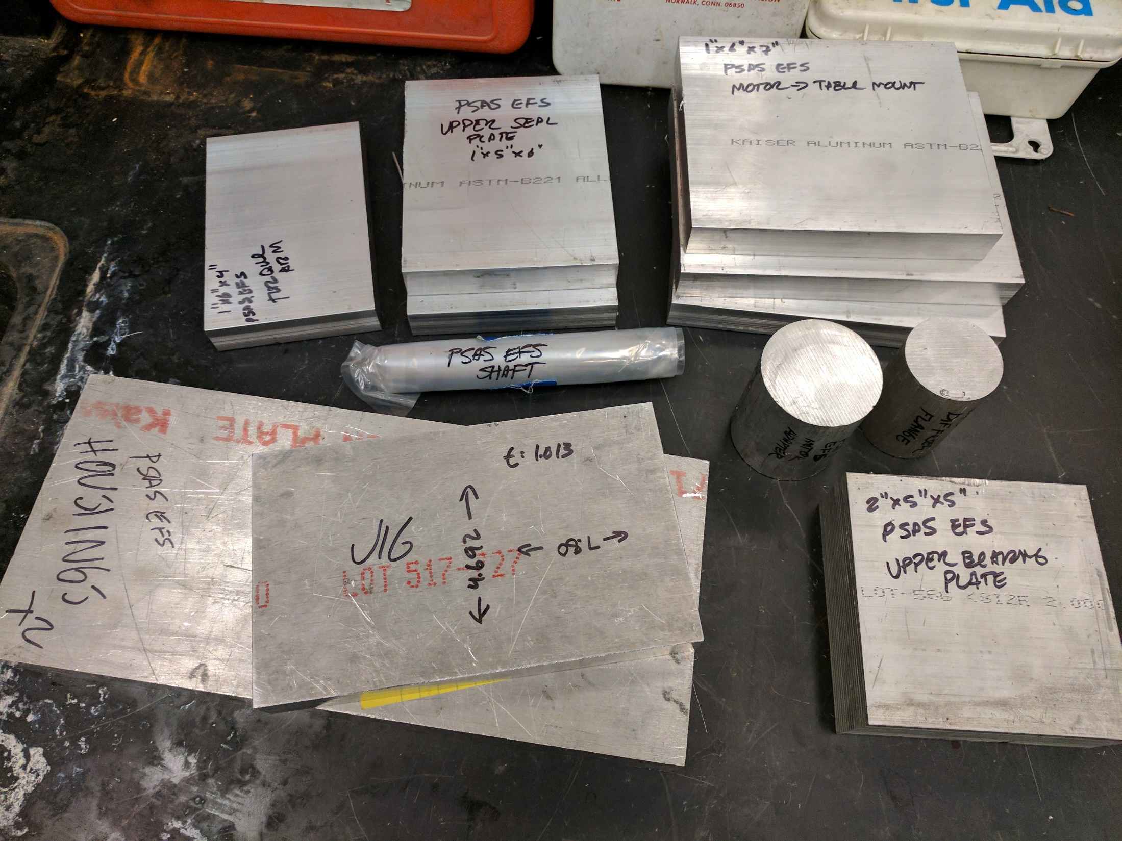
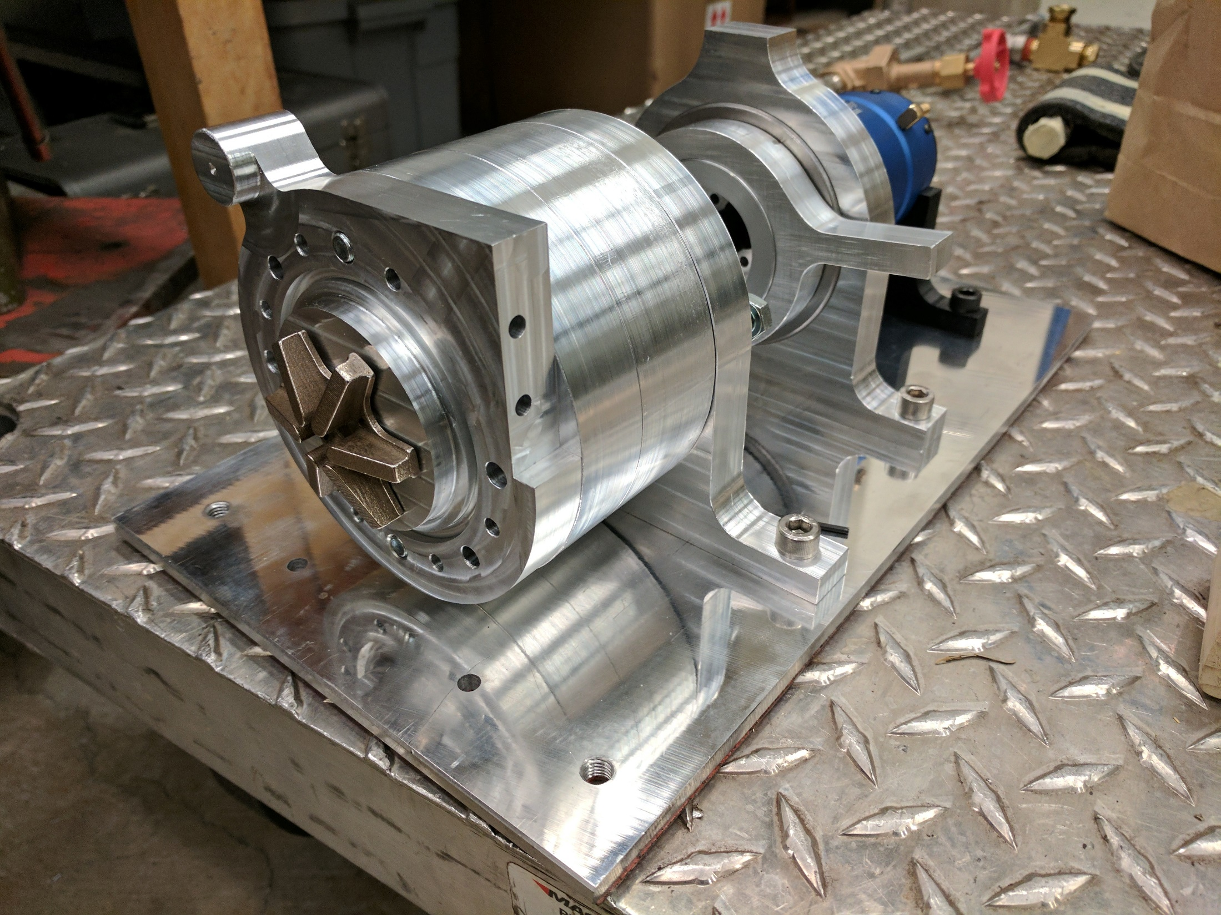
Challenges & Solutions: Fabrication
Fabrication takes a lot of time.

Slide 4
Challenges & Solutions: Fabrication
Fabrication takes a lot of time.

Slide 5
Challenges
To insert:
Quarter section – Cad Model
Bearing Schematic ? – Diagram
CNC operation – High res of john/james/kris
Hours in machine shop - Figure
Notes:
Casing Design and Manufacturing
Problems:
High RPMs / High Pressure
Alignment / Clearances / Fits
Ensuring Safe operation and preventing leakage
Solutions:
Bearing arrangement and selection
Seal / bushing
Precision execution with 3 axis CNC
Portland State Aerospace Society | Electric Propellant Feed System

Slide 6
Challenges
To insert:
Photo, highlight sensors
Photo, DAQ
Photo, Motor control
Notes:
2. Controls / Measurement
Problems:
Motor control
Sensing and measurement for performance curves
Solutions:
Quad Copter rigging / controller potentiometer tricking
Sensors
Arduino DAQ
Portland State Aerospace Society | Electric Propellant Feed System

